Slide 1
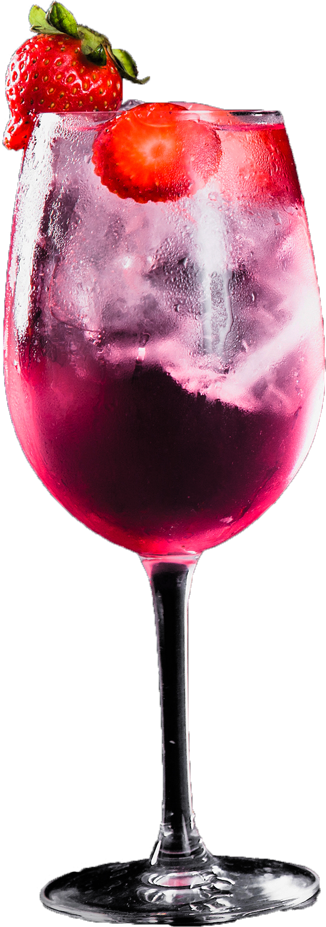
EP MiniMixer
Емилиана Петренко 11Б и Петя Дамянова 11Б

Slide 2
Съдържание
Идея
Технологии
Реализация
Демо
01
02
03
04

Slide 3
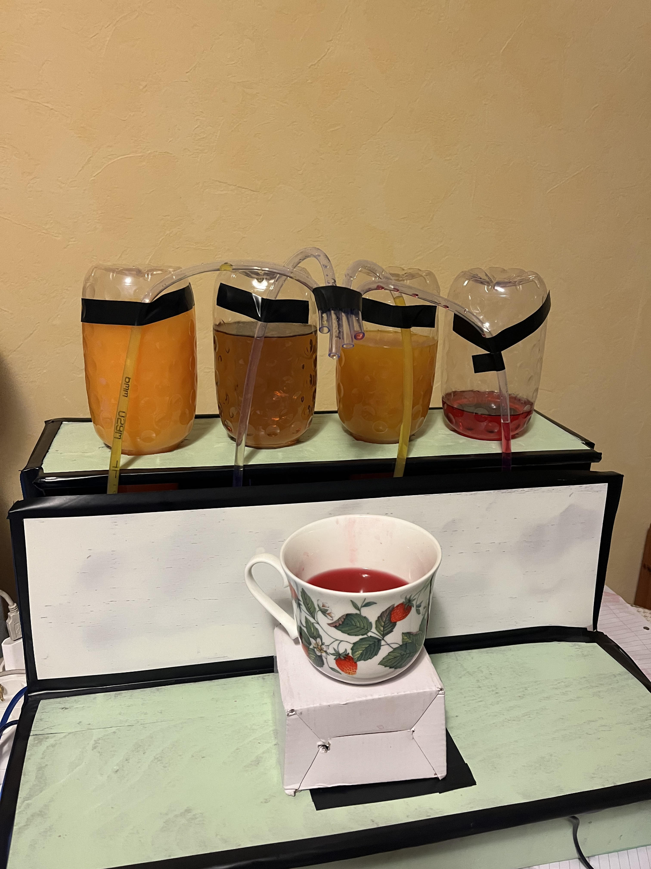
Идея

Slide 4
Технологии
Flutter
C++
Venus has a beautiful name and is the second planet from the Sun
Despite being red, Mars is actually a cold place. It’s full of iron oxide dust

Slide 5
Демо

Slide 6
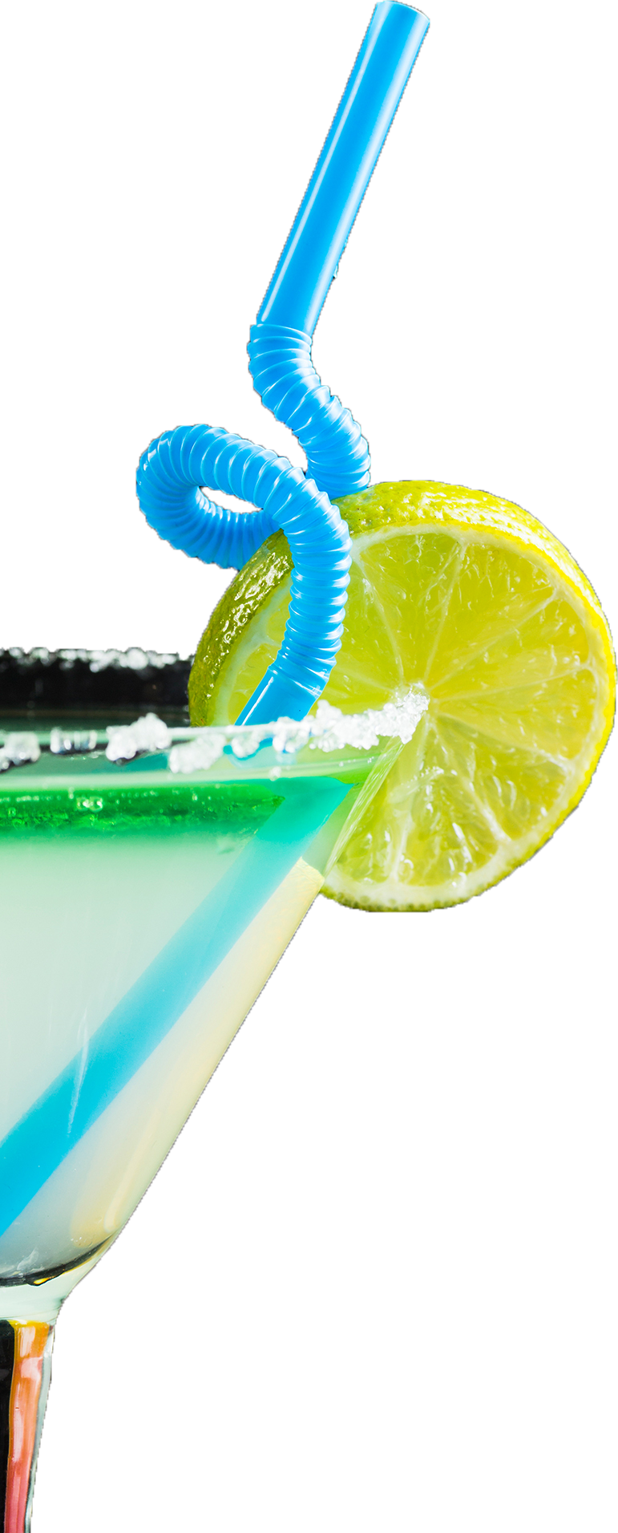
Благодарим за вниманието!

Slide 7
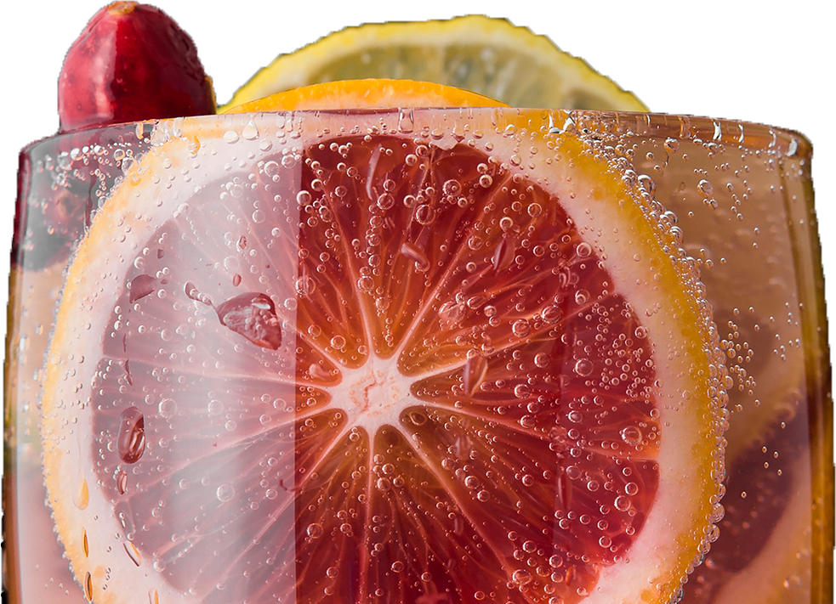
Въпроси?
And this is the subtitle that makes it comprehensible

